Slide 1

Reinforcement Learning
Q-Learning Algorithm

Slide 2
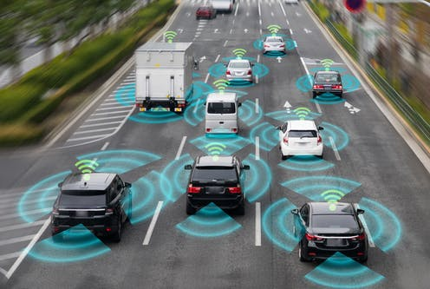
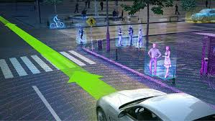
Autonomous Cars
State space:
?

Slide 3
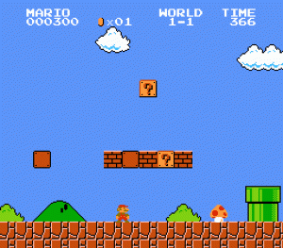
Autonomous Cars
Simpler environment
Fewer variables on the state space
Controlled by Open AI Gym.

Slide 4
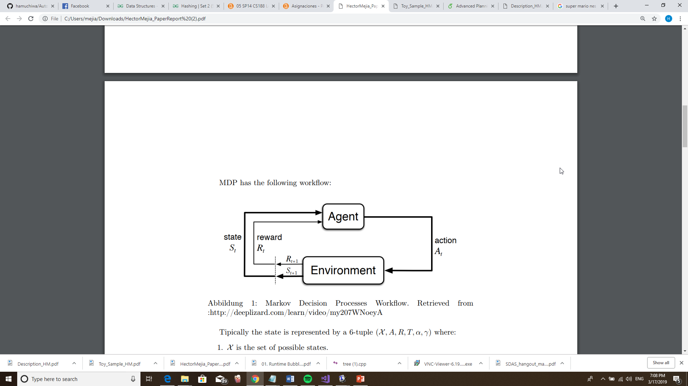
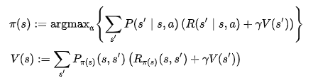
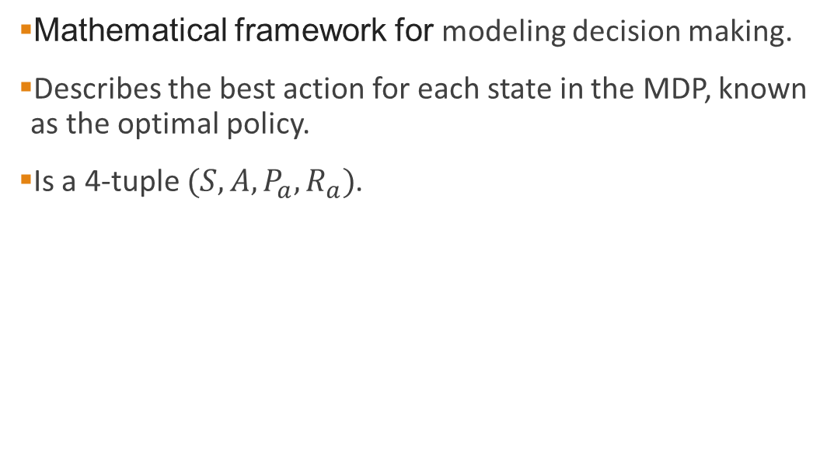
Markov Decision Process
Mathematical framework for modeling decision making.
Describes the best action for each state in the MDP, known as the optimal policy.
Is a 4-tuple $(S,A,P_{a},R_{a})$.

Slide 5
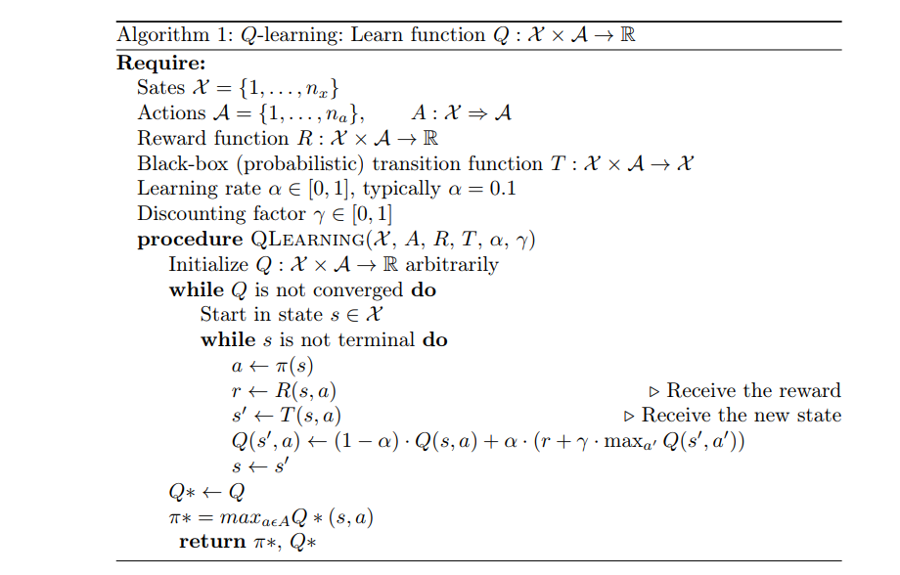
Q learning Algorithm
Determines best policy to achieve goal state.
Key items:
States, actions
Q table
Policy Function
Reward Function
Transition Function

Slide 6
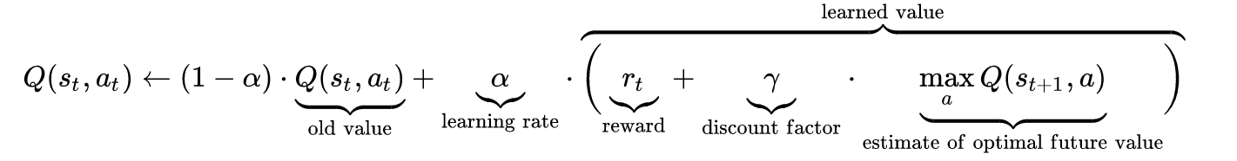
Desktop Test
The Bellman Equation:

Slide 7
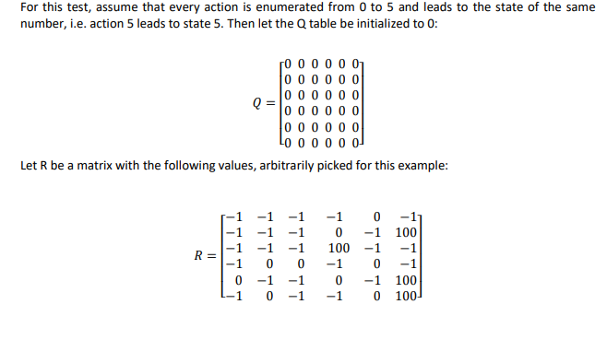
Desktop Test

Slide 8
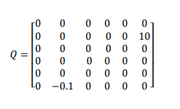
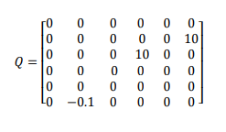
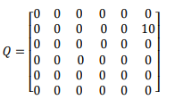
Desktop Test
Q(1,5) Q(5,2) Q(2,3)

